Slide 1
Markups
Get base plot from ggplot outputs

Slide 2
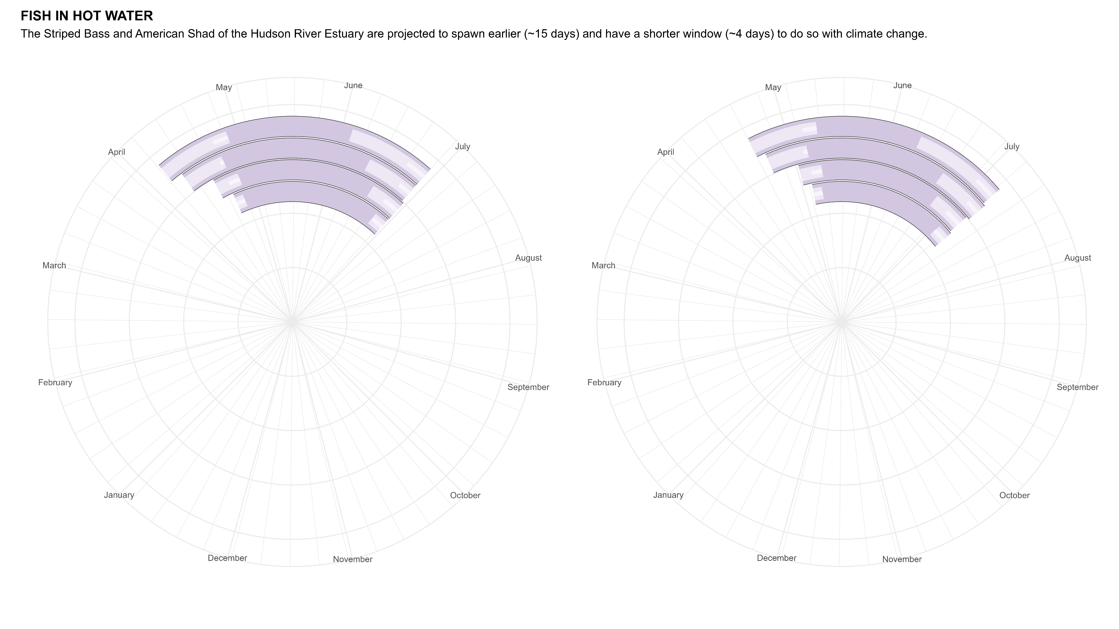
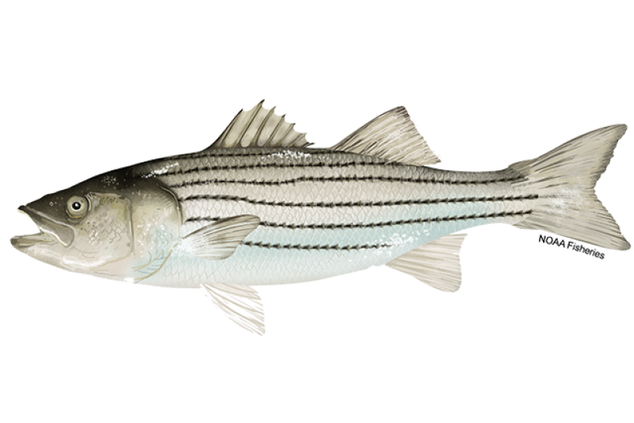
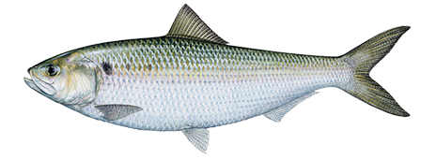
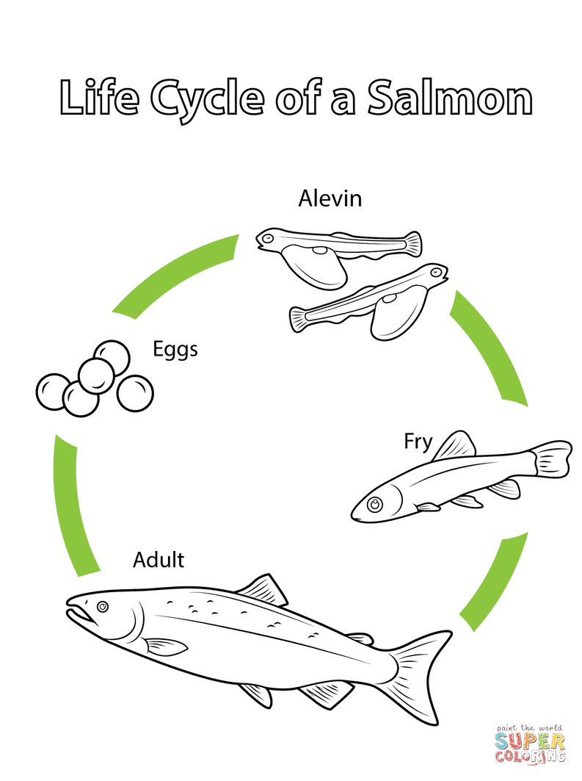

NOT THIS ONE
FISH IN HOT WATER
Under projected climate change scenarios, the American Shad and Striped Bass of the Hudson River Estuary are predicted to spawn 15 days earlier on average.
RCP
8.5
RCP
8.5
6.0
-26
-20
6.0
-27
-22
4.5
-13
-14
-17
-8
4.5
-9
2.6
Spawning Starts
-4
-17
Spawning Starts
-4
-13
2.6
Spawning Ends
-13
-6
Spawning Ends
-6
Adult
American Shad
Eggs
Striped Bass
HOW TO READ THE PLOT
The Representative Concentration Pathways (RCP) labeled are future scenarios constructed to represent how well we are able to curb and contain greenhouse gas emissions with RCP 2.6 implementing the most aggressive strategies and RCP 8.5 being “business-as-usual.” Their position on the y-axis of the plot above is ordered from RCP 2.6 to RCP 8.5 but their distance from the center of the circle is not significant.
Larva
Fry
Shift [days]
Possible
Spawning Range
Projected
(2012 – 2099)
It takes a 2-4 years for the eggs to mature
Data Source: Nack, C. et. al. (2019). https://doi.org/10.1002/mcf2.10076
Fish images from www.takemefishing.org and NOAA Fisheries
Plot made by Ellie White, ewhite@usgs.gov 04/08/2023

Slide 3

NOT THIS ONE
FISH IN HOT WATER
Under projected climate change scenarios, the American Shad and Striped Bass of the Hudson River Estuary are predicted to spawn 15 days earlier on average.
RCP
8.5
RCP
8.5
6.0
-26
-20
6.0
-27
-22
4.5
-13
-14
-17
-8
4.5
-9
2.6
Spawning Starts
-4
-17
Spawning Starts
-4
-13
2.6
Spawning Ends
-13
-6
Spawning Ends
-6
Adult
American Shad
Eggs
Striped Bass
HOW TO READ THE PLOT
The Representative Concentration Pathways (RCP) labeled are future scenarios constructed to represent how well we are able to curb and contain greenhouse gas emissions with RCP 2.6 implementing the most aggressive strategies and RCP 8.5 being “business-as-usual.” Their position on the y-axis of the plot above is ordered from RCP 2.6 to RCP 8.5 but their distance from the center of the circle is not significant.
It takes a 2-4 years for the eggs to mature.
Larva
Fry
Shift [days]
Possible
Spawning Range
Projected
(2012 – 2099)
Data Source: Nack, C. et. al. (2019). https://doi.org/10.1002/mcf2.10076
Fish images from www.takemefishing.org and NOAA Fisheries
Plot made by Ellie White, ewhite@usgs.gov 04/08/2023

Slide 4

NOT THIS ONE
FISH IN HOT WATER
Under projected climate change scenarios, the American Shad and Striped Bass of the Hudson River Estuary are predicted to spawn 15 days earlier on average.
RCP
8.5
RCP
8.5
6.0
6.0
4.5
4.5
2.6
Spawning Ends
Spawning Starts
2.6
Spawning Starts
Spawning Ends
Adult
American Shad
Eggs
Striped Bass
HOW TO READ THE PLOT
The Representative Concentration Pathways (RCP) labeled are future scenarios constructed to represent how well we are able to curb and contain greenhouse gas emissions with RCP 2.6 implementing the most aggressive strategies and RCP 8.5 being “business-as-usual.” Their position on the y-axis of the plot above is ordered from RCP 2.6 to RCP 8.5 but their distance from the center of the circle is not significant.
It takes a 2-4 years for the eggs to mature.
Larva
Fry
Modeling Period
(1950-2012)
Data Source: Nack, C. et. al. (2019). https://doi.org/10.1002/mcf2.10076
Fish images from www.takemefishing.org and NOAA Fisheries
Plot made by Ellie White, ewhite@usgs.gov 04/08/2023

Slide 5
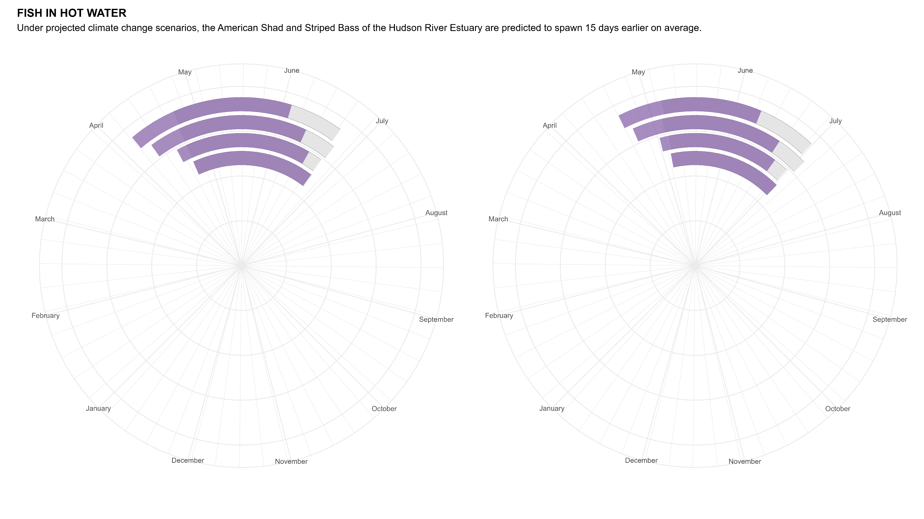
NOT THIS ONE
FISH IN HOT WATER
Under projected climate change scenarios, the American Shad and Striped Bass of the Hudson River Estuary are predicted to spawn 15 days earlier on average.
RCP
8.5
RCP
8.5
6.0
6.0
4.5
4.5
2.6
Spawning Ends
Spawning Starts
2.6
Spawning Starts
Spawning Ends
Adult
American Shad
Eggs
Striped Bass
HOW TO READ THE PLOT
The Representative Concentration Pathways (RCP) labeled are future scenarios constructed to represent how well we are able to curb and contain greenhouse gas emissions with RCP 2.6 implementing the most aggressive strategies and RCP 8.5 being “business-as-usual.” Their position on the y-axis of the plot above is ordered from RCP 2.6 to RCP 8.5 but their distance from the center of the circle is not significant.
It takes a 2-4 years for the eggs to mature.
Larva
Fry
Spawning Range
Modeling Period
(2012-2099)
Data Source: Nack, C. et. al. (2019). https://doi.org/10.1002/mcf2.10076
Fish images from www.takemefishing.org and NOAA Fisheries
Plot made by Ellie White, ewhite@usgs.gov 04/08/2023

Slide 6
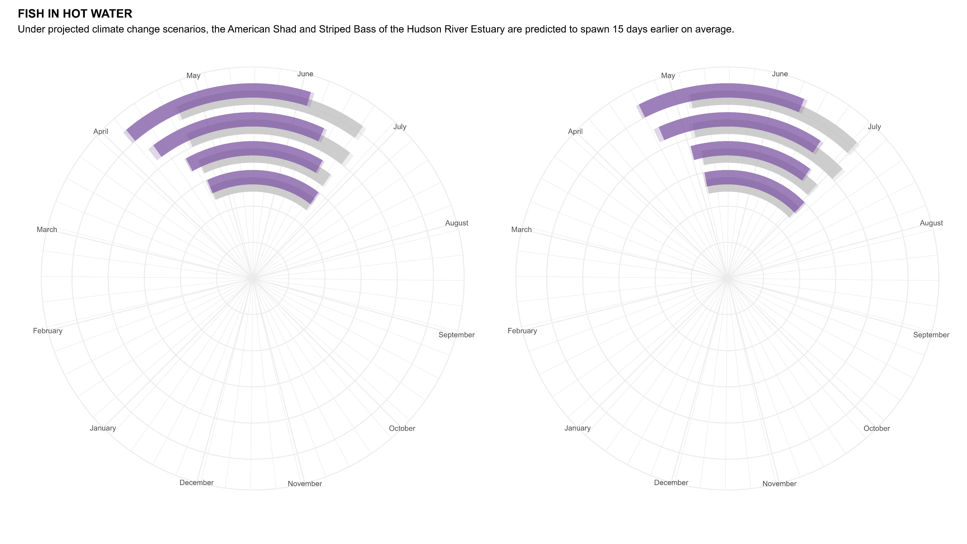
FISH IN HOT WATER
Under projected climate change scenarios, the American Shad and Striped Bass of the Hudson River Estuary are predicted to spawn 15 days earlier on average.
RCP
8.5
RCP
8.5
6.0
6.0
4.5
Spawning
Starts
4.5
Spawning
Starts
2.6
Spawning
Ends
2.6
Spawning
Ends
Adult
American Shad
Eggs
Striped Bass
Representative Concentration Pathways (RCP) are future scenarios constructed to represent how well we are able to curb and contain greenhouse gas emissions with RCP 2.6 implementing the most aggressive strategies and RCP 8.5 being “business-as-usual.” Their position on the y-axis of the plot above is ordered from RCP 2.6 to RCP 8.5 but their distance from the center of the circle is not significant.
HOW TO READ THE PLOT
It takes 2-4 years for the eggs to mature.
Larva
Modeling Periods
Fry
2012-2099
1950-2012
Standard
Error
Data Source: Nack, C. et. al. (2019). https://doi.org/10.1002/mcf2.10076
Fish images from www.takemefishing.org and NOAA Fisheries
Plot made by Ellie White, ewhite@usgs.gov 04/08/2023

Slide 7
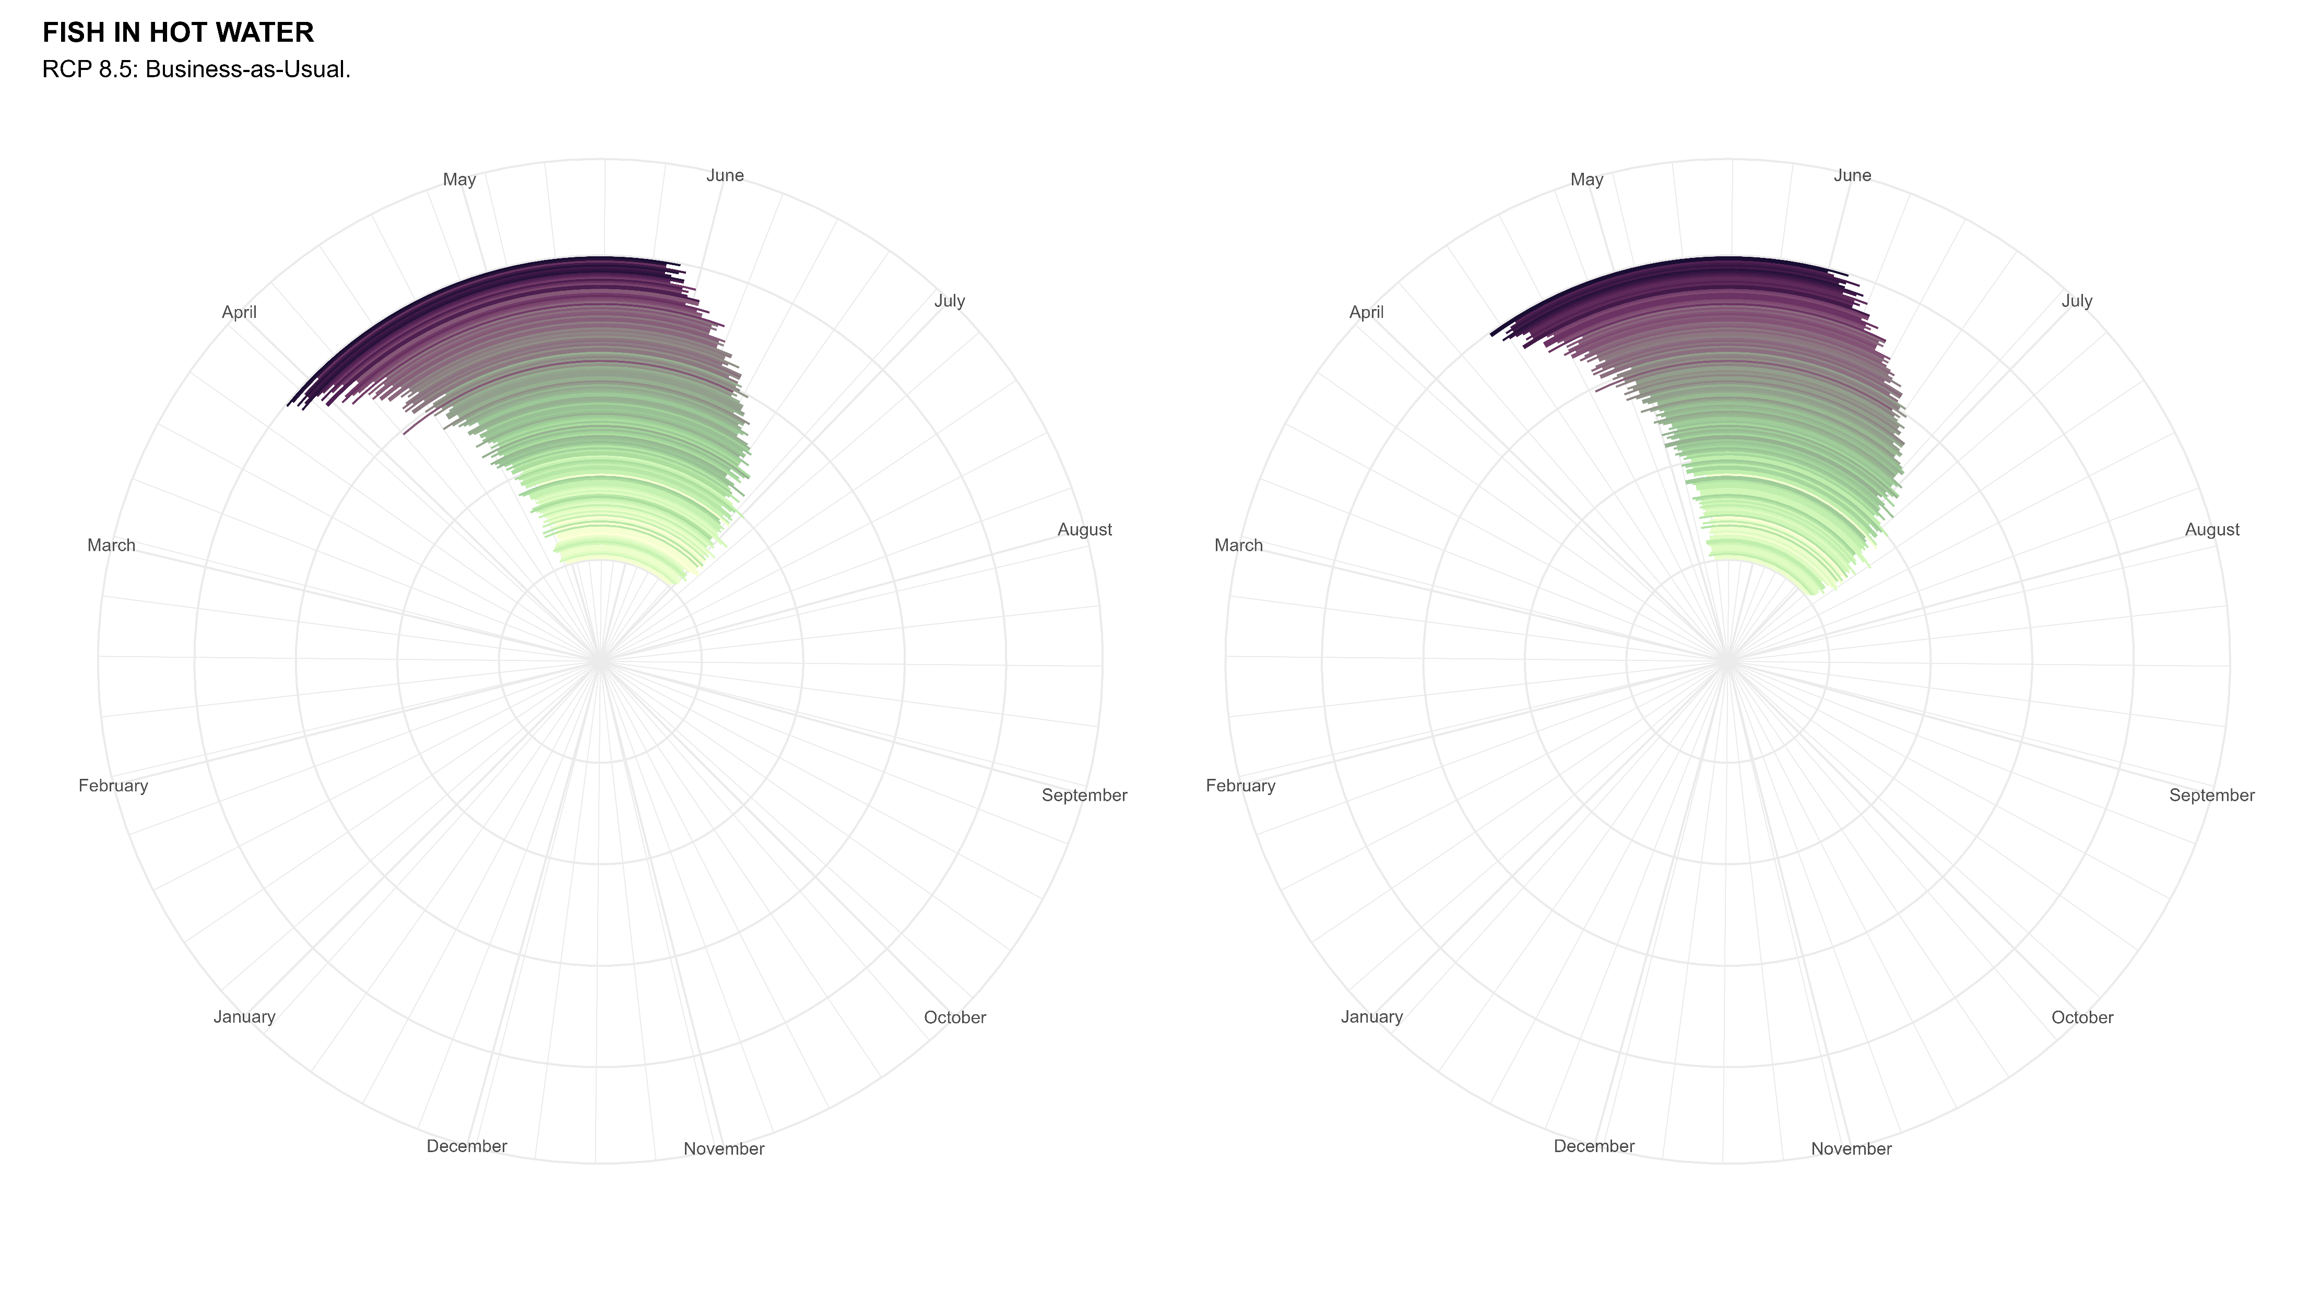
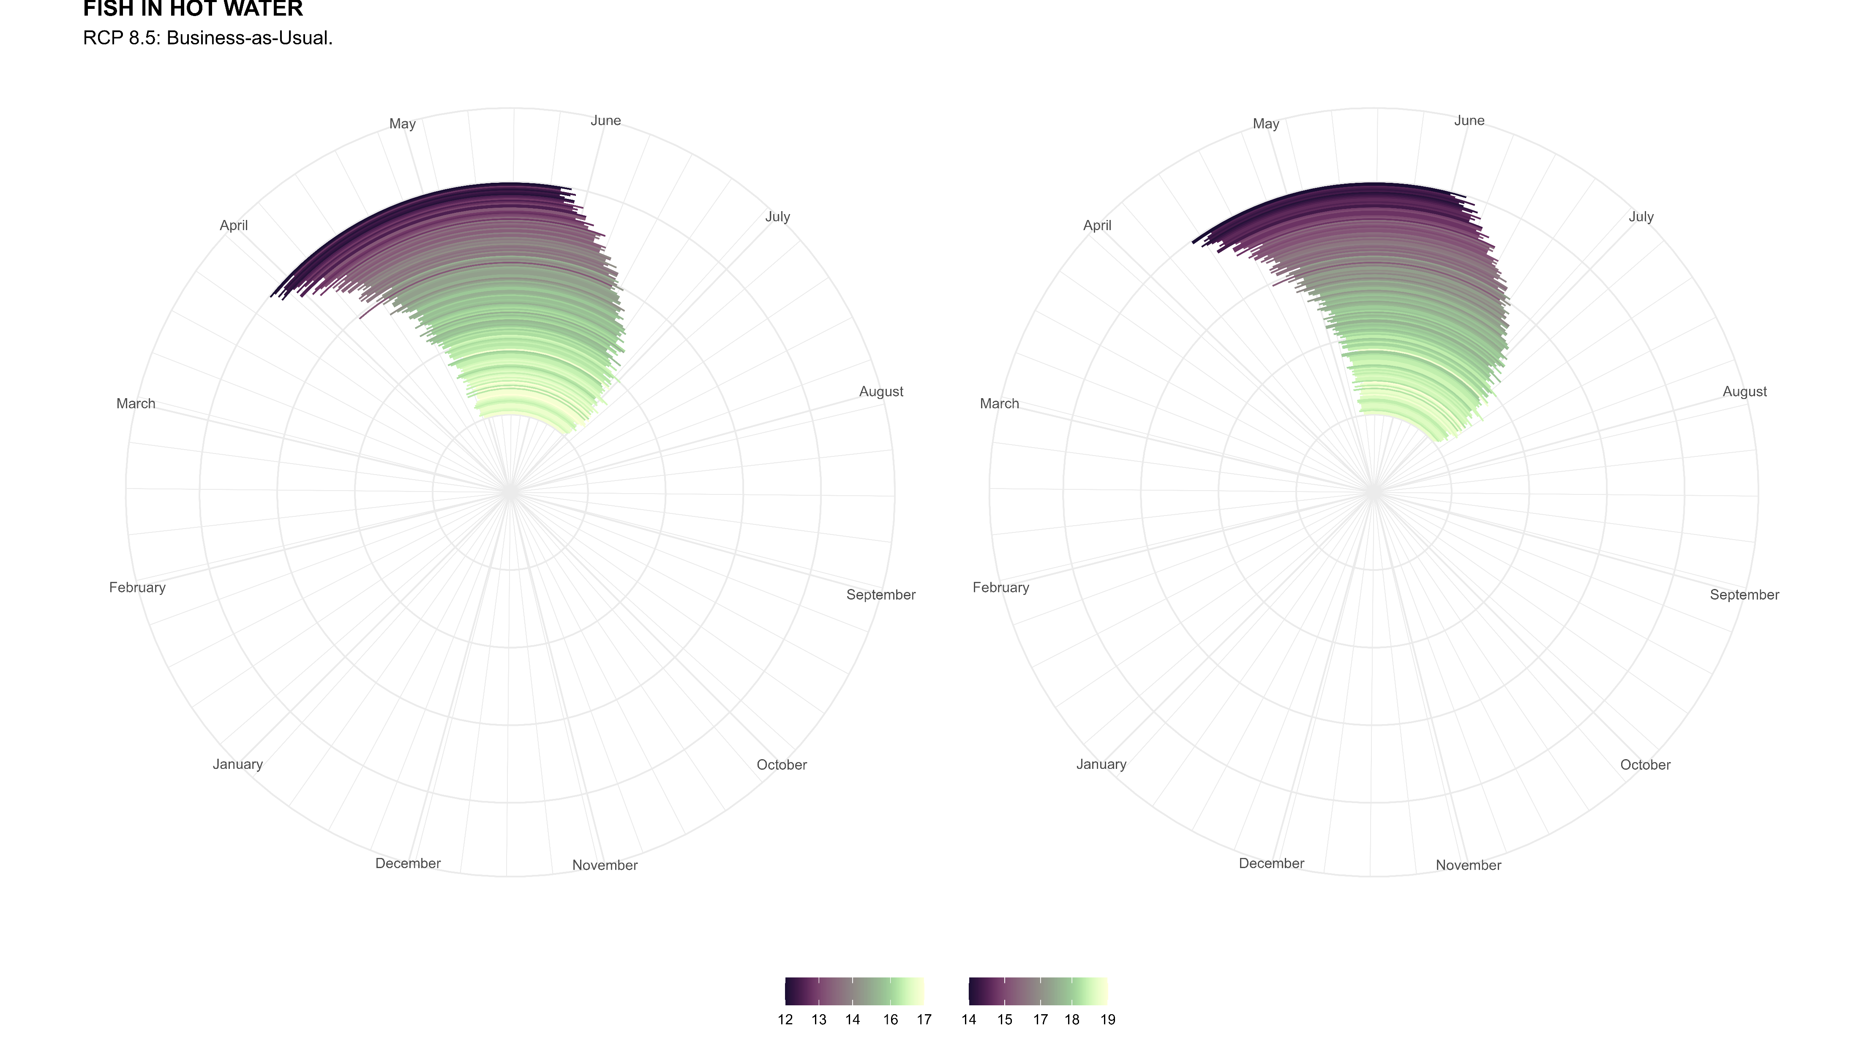
FISH IN HOT WATER
Under RCP 8.5 (“business-as-usual”), the American Shad and Striped Bass of the Hudson River Estuary are projected to start and stop spawning 20 and 26 days earlier on average respectively.
2099
2099
1950
1950
American Shad
Striped Bass
Spawning Start
Week Number (0-53)
Spawning Start
Week Number (0-53)
Data Source: Nack, C. et. al. (2019). https://doi.org/10.1002/mcf2.10076
Fish images from www.takemefishing.org and NOAA Fisheries
Plot made by Ellie White, ewhite@usgs.gov 04/08/2023

Slide 8
Extra Text
Native and Colonial Americans fished them for sustenance, smoked the flesh, and ate the roe as a delicacy.
The American Shad and the Striped Bass are migratory species needing both freshwater and marine habitats to complete their life cycle. This makes them particularly vulnerable to human activities. The Hudson River Shad has declined in stock so much that all its fisheries were closed in 2010. The Striped Bass, while declining in relative abundance, still remains the most important game fish in the Hudson River.

